Slide 2
Agenda of the meeting
Review of the previous session
Introduction to Business Model
Types of Business Models
References of some business models

Slide 3
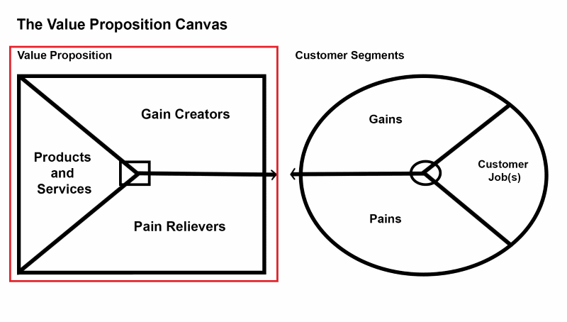
Crafting a Value Proposition Canvas Model
Expected

Slide 4
Customer pains in getting the jobs done
The customer has to go out in the traffic
Parking problem
Limited choice of items
Problem in carrying food

Slide 5
Unit-III
Introduction to Business Models
Crafting lean canvas business models
Blue ocean vs Red ocean strategy
Solution Demo
Building MVP

Slide 6
Business Model
A company's business model a business model details how an organization creates and delivers products or services, l is an important representation of how a company does business.
some of the examples are subscription-based, freemium, and the franchise model.
Depending on what your business makes or does, one of those revenue-generating models will probably rise to the top as the most appropriate way to run your business.

Slide 7
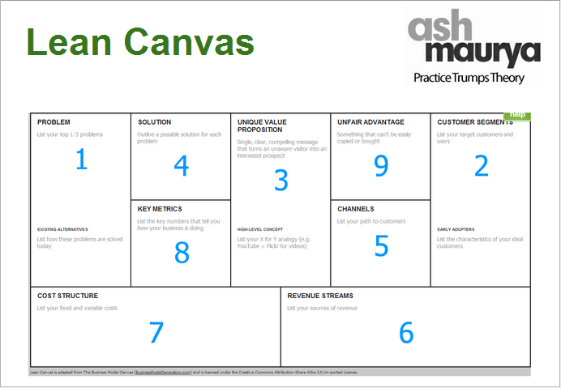

Slide 8
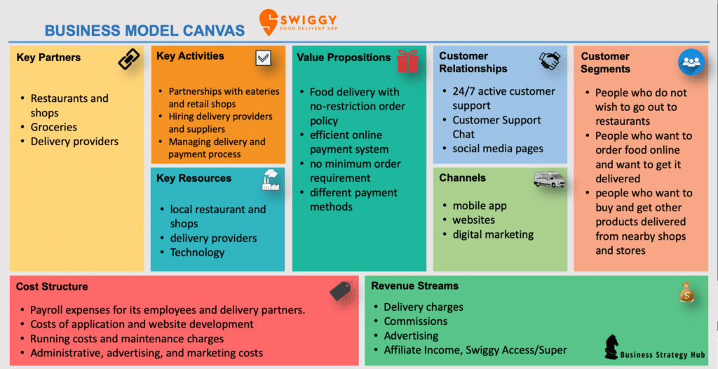

Slide 9
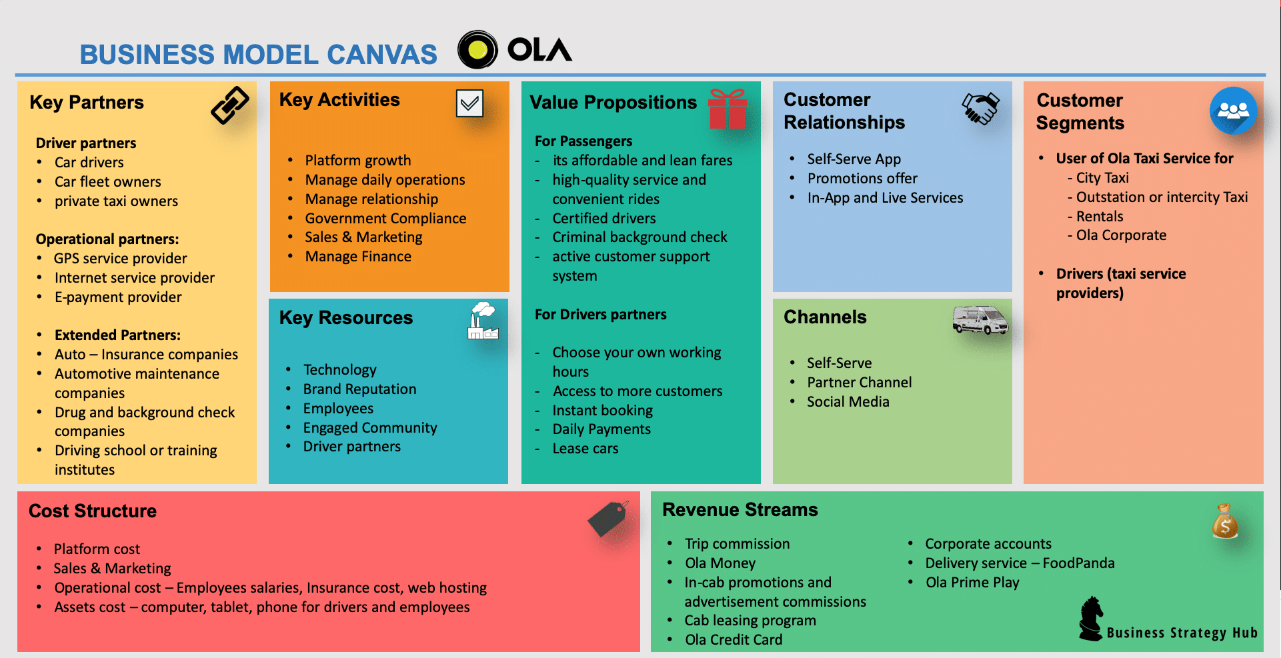

Slide 10
